Slide 1
AST20207 Application for Portable Devices
Group 9
Leung Wai Kwong
Chan Hang Kit
Ngan Frankie
Lam Ho

Slide 2
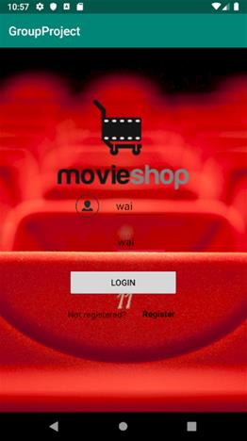
When you open the application
User can login with their account. If they don’t have an account, they can click register to create their own account.

Slide 3
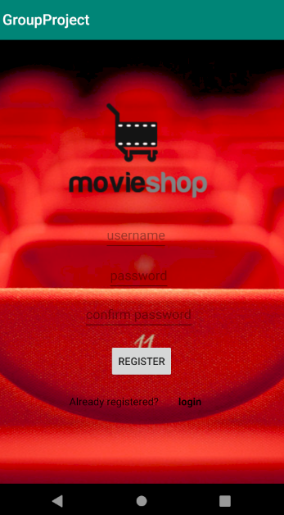
Register Page
User can input the username the like
We use double input to confirm user didn’t input wrong password

Slide 4
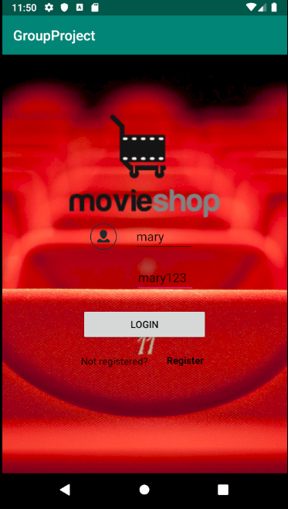
Login Page
According the project requirement, we use
User1:
user name: mary PW:mary123
And click login

Slide 5
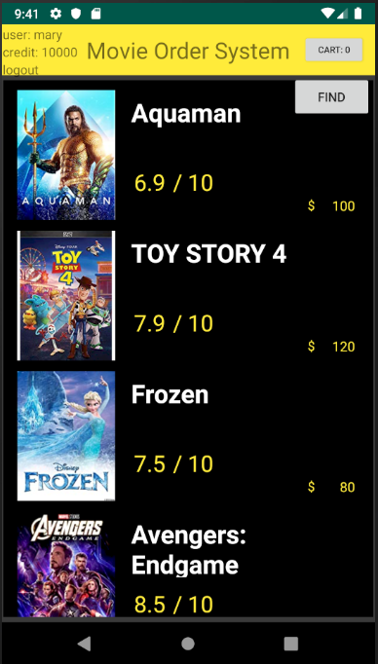
Main Screen
User name
User Credit
It show all movies with the poster, name,price and rating
A button for user log out

Slide 6
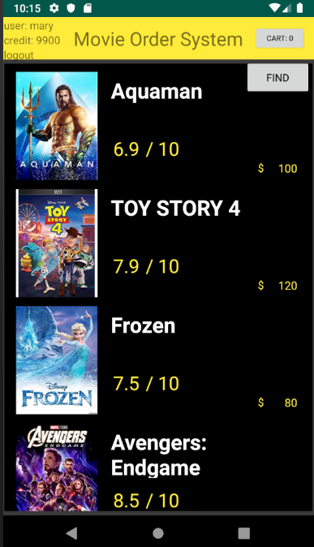
Part B special technical/design merit
Allow the user to search a movie by movie name.
Display of an image of the movie in the main menu ( for example, listview)

Slide 7
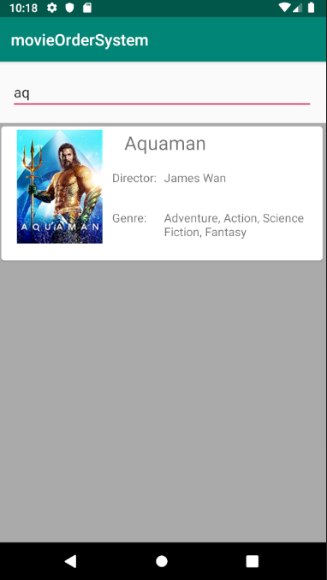
Search Movie
We input “aq” in the edittext,and it finally show “Aquaman” as a result

Slide 8
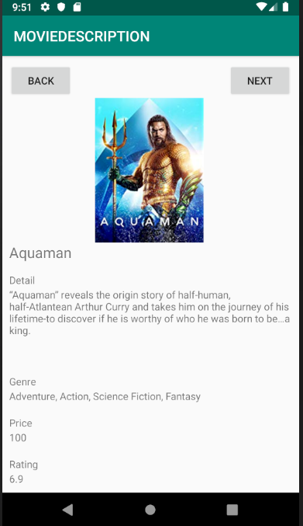
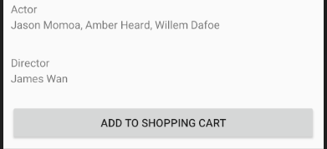
Movie Detail Page
User can click this to go to next movie detail page
When User click one of the movies, it will show the movie detail and genre, price , rating, actor, director.
User can click this to go to previous movie detail page

Slide 9
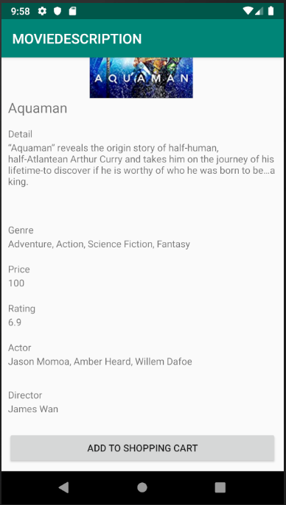
Add to cart
If user like to purchase this movie, the can click this button
And go back to main page.

Slide 10

Finish Checkout
User click the cart button and finish the check out

Slide 11
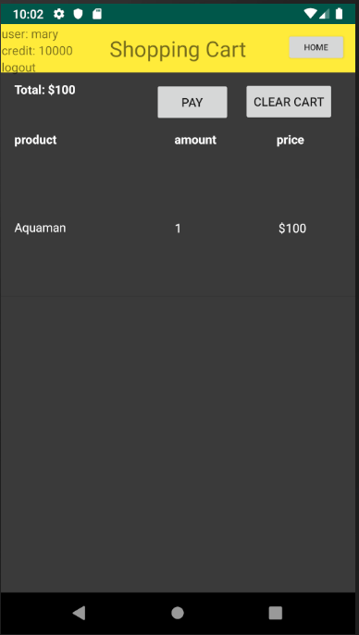

Shopping Cart
It will help user to calculate the amount of movies and price.
The cart will clear when user finished the check out
If the user accidentally adds the wrong item,they can go to cart page and clear the cart
The credit has been updated
User use their credit to pay and finish check out process

Slide 12
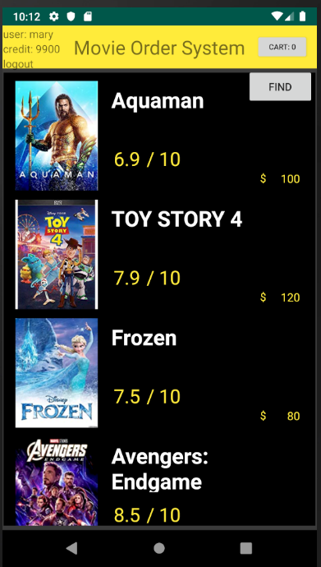
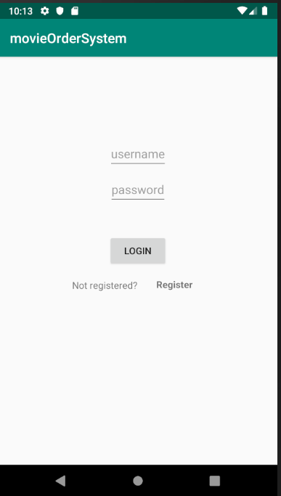
User can click “home” button to go to main page
Click logout and back to login page

